Slide 1
FINAL PRESENTATION
GROUP 4

Slide 2
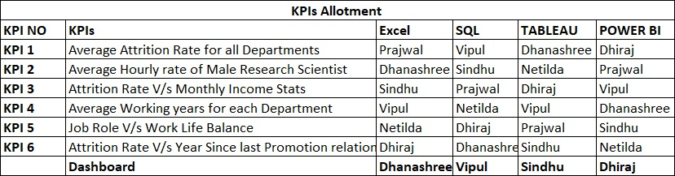
INTRODUCTION
Employee Retention
Tools used : Excel, MySQL, Tableau, Power BI
KPI allotment

Slide 3
OBJECTIVES
Develop Analytical Dashboard – Bird View.
Identify attrition patterns across departments and income levels
Benchmark compensation for key roles against industry standards
Evaluate employee work-life balance and burnout risk across job roles
Assess career stagnation through promotion history and tenure data
Which departments are losing talent the fastest?

Slide 4
WEEK 1- EXCEL DASHBOARD
Presented by : Dhanashree
Presentation Date : 19/05/2026, Presented on : 26/05/2026
KPI Contributors : Dhanashree, Dhiraj, Netilda,Prajwal,Sindhu, Vipul

Slide 5
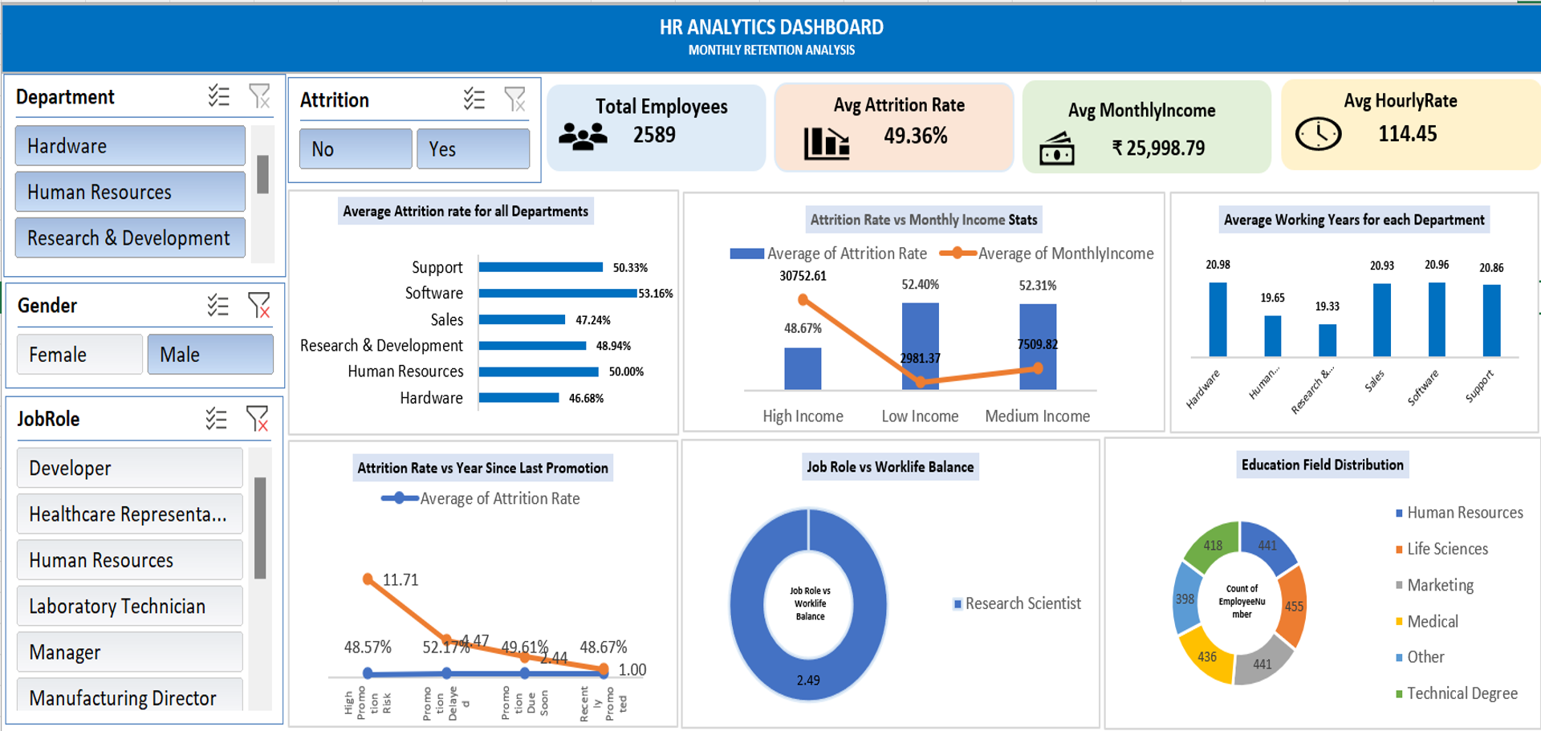

Slide 6
Challenges
Data Modelling Challenges
Establishing relationships between HR_1 and HR_2 datasets.
Selecting the correct primary key (Employee Number).
Avoiding duplicate counts after merging.
Creating calculated fields for KPIs.
Maintaining consistency across Pivot Tables and Charts.

Slide 7
WEEK 2- SQL, TABLEAU DASHBOARD
SQL DASHBOARD
Made & Presented by : Vipul
Presentation Date : 26/05/2026, Presented on : 26/05/2026
KPI Contributors : Dhanashree, Netilda, Prajwal, Sindhu, Vipul
TABLEAU DASHBOARD
Made & Presented by : Sindhu
Presentation Date : 26/05/2026, Presented on : 26/05/2026
KPI Contributors : Dhanashree, Netilda, Dhiraj,Prajwal, Sindhu, Vipul

Slide 8
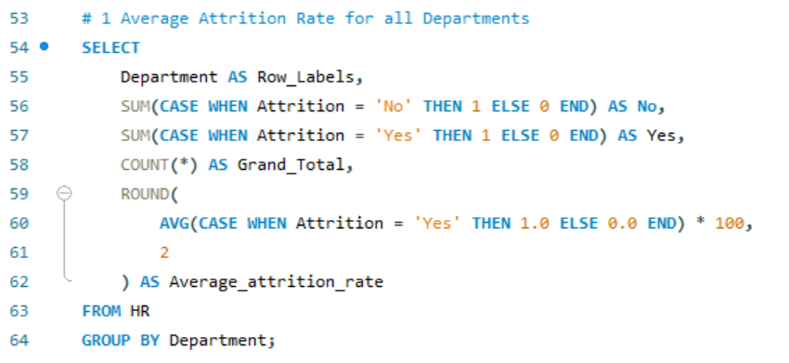
Q) Which department are bleeding talent the fastest?
What it Means :- Instead of guessing why the whole company is losing staff, this tells us exactly which manager or department is losing the most people.
That way, we know exactly where the problem is.

Slide 9
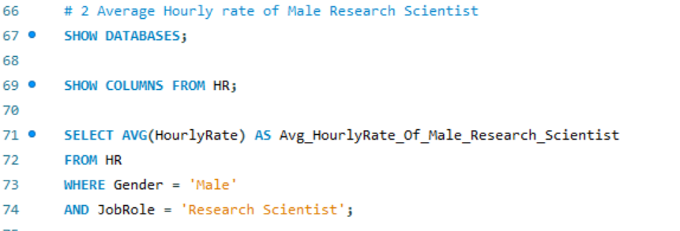
Q) What is the standard market pay for a specific, highly skilled role?
What it Mean:- By finding the baseline ($65.80 for Male Research Scientists), the company can check if they are underpaying (which causes people to quit) or overpaying (which hurts the budget) compared to the internal average.
This check the average paycheck for a specific role (like a scientist). It makes sure we are paying enough to keep them happy, but not so much that we are wasting company money.

Slide 10
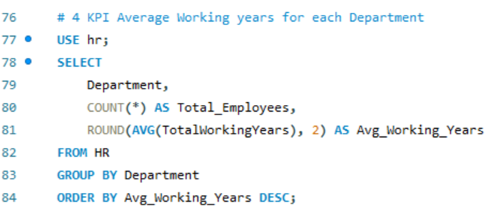
Q) How long do people typically build their careers in different area of our company ?
What it Mean:- It help measure departmental health over time. If Sales employees only last 9 years but R&D is stays for 11, HR can investigate what R&D is doing right to keep people engaged for the long haul.
This simply counts the average number of years people stay in different departments. If people in one department stay for 10 years but another group leaves after 2 years, we need to figure out why the second group is so happy.

Slide 11
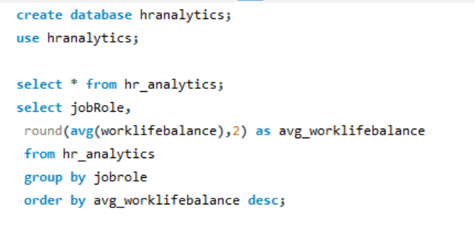
Q) Work life Balance Index :- Are the day to day demands of certain jobs causing burnout?
What It Mean:- It shift the focus from money to well being by seeing that lab technicians score lower on balance due to shift work, management can intervene with flexible scheduling before those employees get too exhausted and quit.

Slide 12
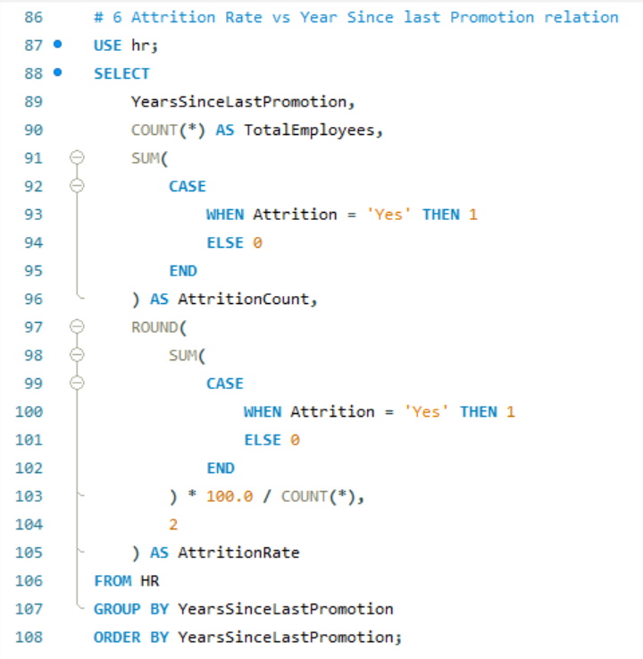
Does a lack of career advancement push our employees out the door ?
What is Means :- This measures the “stagnation risk.” If a large percentage of people quit specifically because they haven’t been promoted in 5 years, the company needs to create better career pathways or risk losing experience talent.
This tracks how long it has been since someone got a promotion. It tells us it employees are getting bored and leaving because they feel like their career is stuck at a dead end.

Slide 13
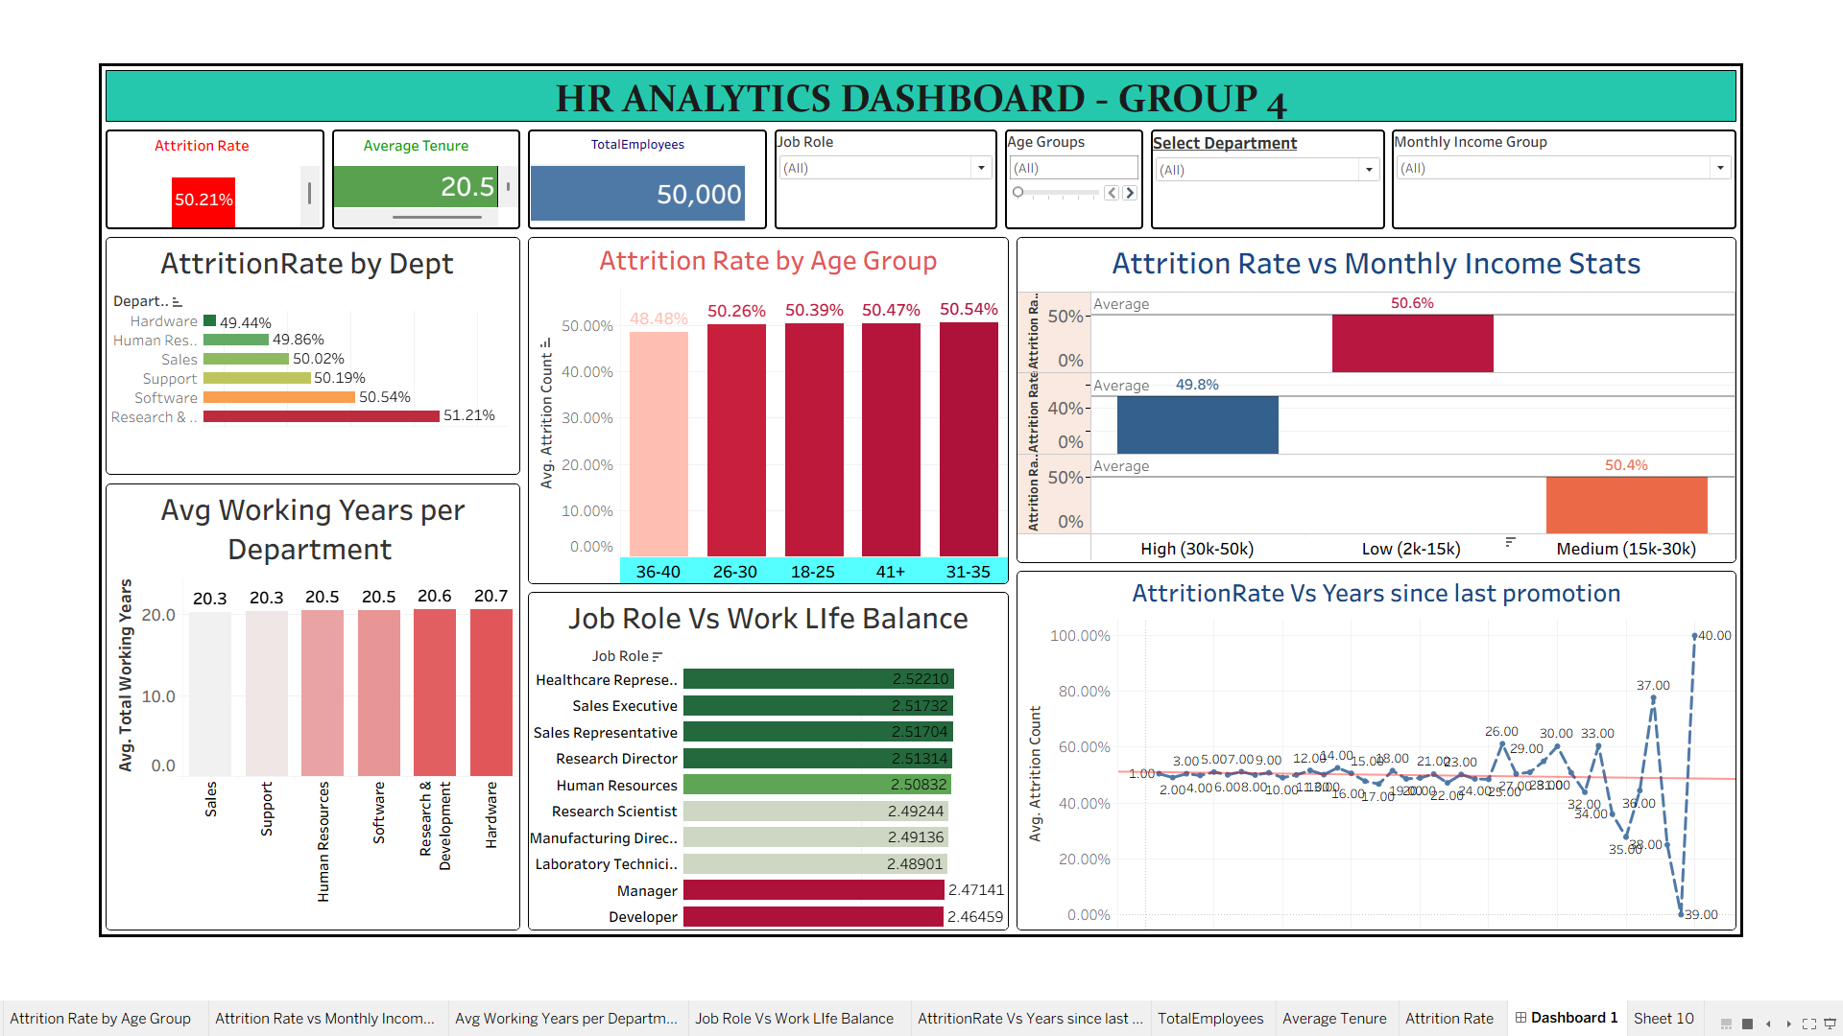

Slide 14
Challenges :
TECHNICAL:
Merging different Workbooks into one Dashboard:
Solution – Recreated the sheets.
Time Consumption in Visualising the Dashboard:
Solution – Need more practice.

Slide 15
WEEK 3- POWER BI DASHBOARD
Made by: Sindhu
Presented by :Netilda
Presentation Date: 02/06/2026, Presented on : 02/06/2026
KPI Contributors : Dhanashree, Netilda, Sindhu, Vipul

Slide 16
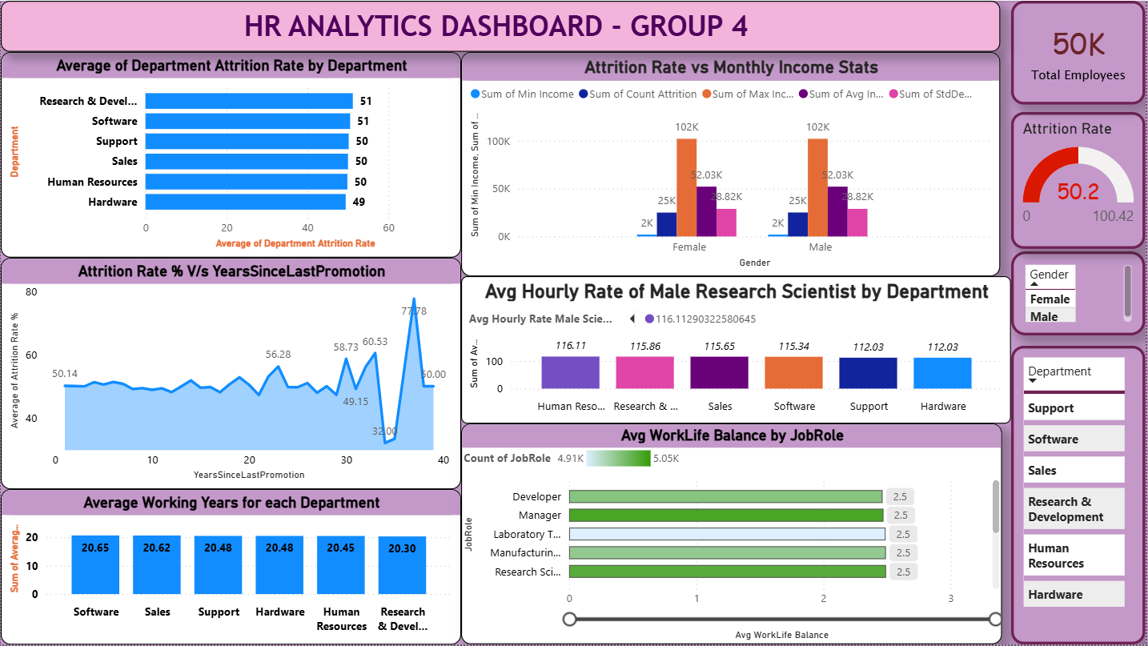

Slide 17
Challenges:
TECHNICAL :
Merging different KPI pages to build 1 Final Dashboard
Solution:
S1- from Source File, Copy Visual> Paste on new page in Destination File.
S2- from Source File, Export data > New folder
S3 – On Destination Page > Get Data > Text/CSV>Select the exported file > load> desired changes in filters and Visualisation

Slide 18
KEY PERFORMANCE INDICATORS
👥 Total Employees Across All Departments
⚖️
📉
📅
50k
50.2%
2.5 / 4
20.5
Avg Work-Life Balance
Avg Working Years
Attrition Rate
Company-wide average
Uniform across all roles
Per department avg
📊 Insight: The attrition rate of 50.2% is notably high, suggesting significant workforce turnover. All 9 job roles report identical work-life balance scores of 2.5, indicating a systemic pattern worth investigating.

Slide 19
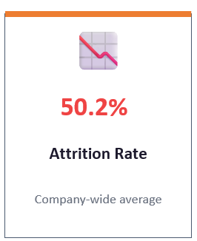
Healthy Rate : 10-15% Here, Around 40%
Risks:
Lost Productivity
Recruitment, Onboarding Costs
Leadership Gaps
Sign of Dissatisfaction
Suggestions:
attrition is systemic rather than department-specific.
need to address company-wide factors such as culture, policies, or career growth opportunities rather than focusing only on one department.

Slide 20
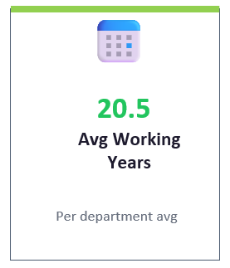
Normal Range: 4-8 yrs (Entry Level to Senior Level) Here,
Around 12.5 yrs
Risks:
Lack of Advancement opportunities
Mid-Late Career disengagement
Reduced Innovation
Resistance to change
Skill stagnation
Lack new Perspectives
Suggestions:
Explore Career Pathing for Senior Employees
Promote Internal Mobility – for challenged employee engagement
Encourage continuous learning through training and certifications

Slide 21
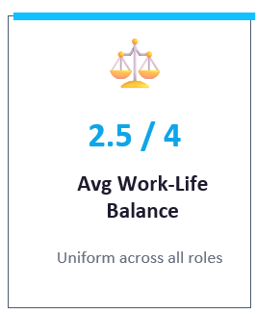
Healthy Benchmark: 3 out of 4
Here, Moderate Satisfaction
Around 0.5
Risks:
High Burnout Risk if unaddressed.
Health issues due to High (114.45 hrs) Average Working Hours
Leads to High Attritions
Suggestions:
Encourage flexible schedules to reduce stress.
Offer wellness programs to support mental health.
Promote realistic workloads by auditing tasks and redistributing.
Strengthen leave policies to align with global best practices.

Slide 22
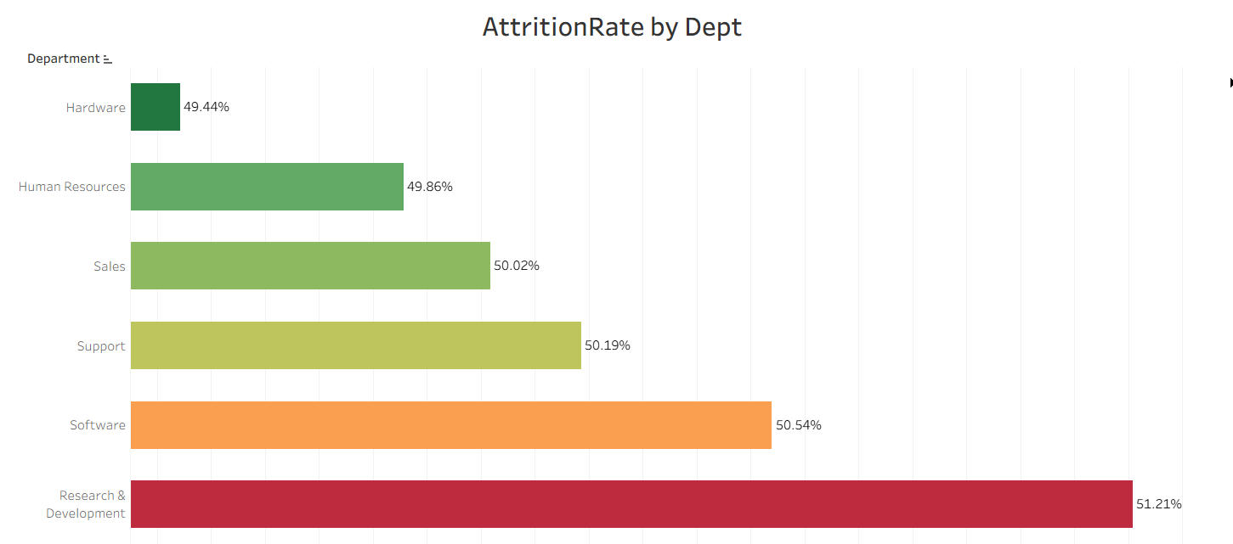
KPI 1 : Average Attrition rate for all Departments

Slide 23
Insights & Recommendations
Attrition is fairly consistent across departments, but R&D stands out at 51.21%, compared to Hardware at 49.44%.
Recommendations
Conduct employee satisfaction surveys
Improve career growth opportunities.
Introduce retention and engagement programs

Slide 24
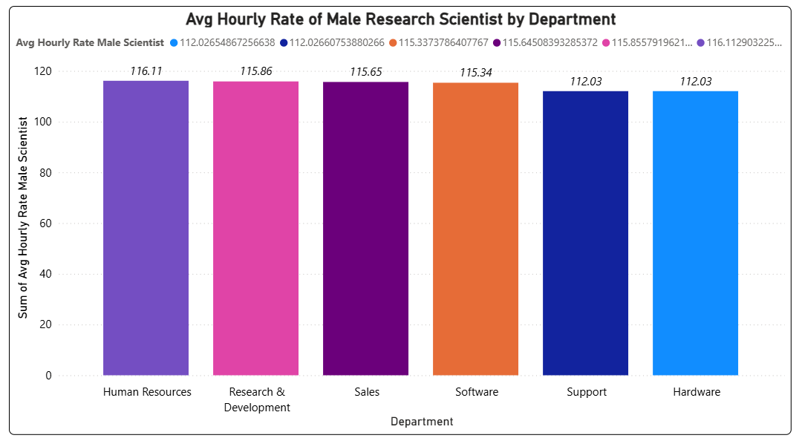
KPI 2: Average Hourly rate of Male Research Scientist

Slide 25
Insights & Recommendations
Current Healthy Average Hourly Rate in India is about ₹500/- per hr. But, here the Max range is 116/-
Experience Level | Hourly Rate (INR) | Notes
Entry-level (1–3 yrs) | ~₹366/hr | Junior roles, often post-M.Sc. or PhD
Mid-level (4–7 yrs) | ~₹450–₹520/hr | Assistant Scientist / Lecturer
Senior (8+ yrs) | ~₹570/hr | Senior Scientist / Associate Professor
Top-tier (10+ yrs, R&D Director, Professor) | ₹1,400–₹5,700/hr | Industry leadership, consultancy income

Slide 26
Risks
Talent Drain
Low Morale
Employer Reputation
Recommendations
Set salaries aligning Industry standards
Offer Non Monetary Benefits like : Flexible Work, International Exposure, Research Funding
Invest in Recognition Programs

Slide 27
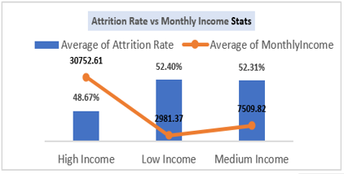
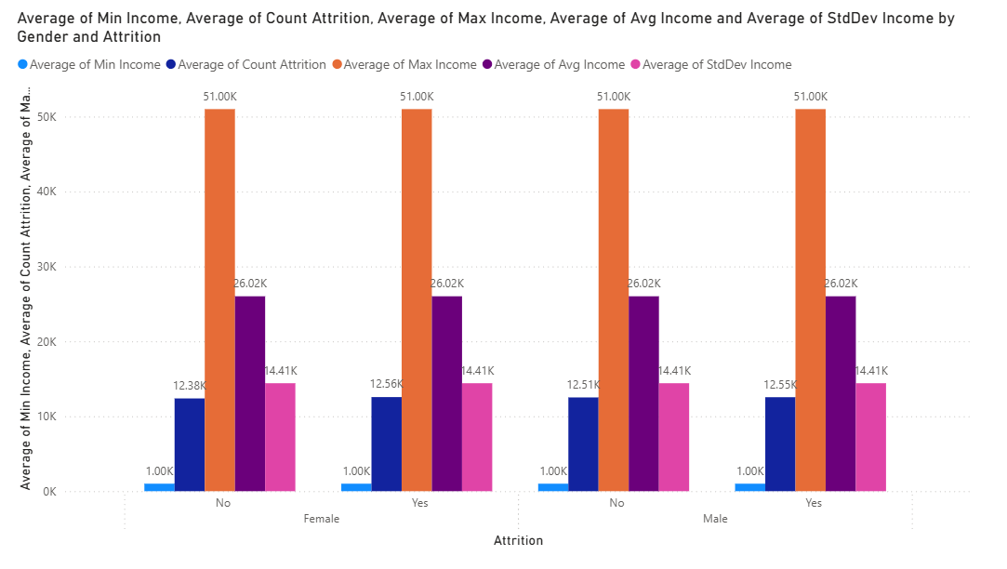
KPI 3: Attrition rate Vs Monthly income stats

Slide 28
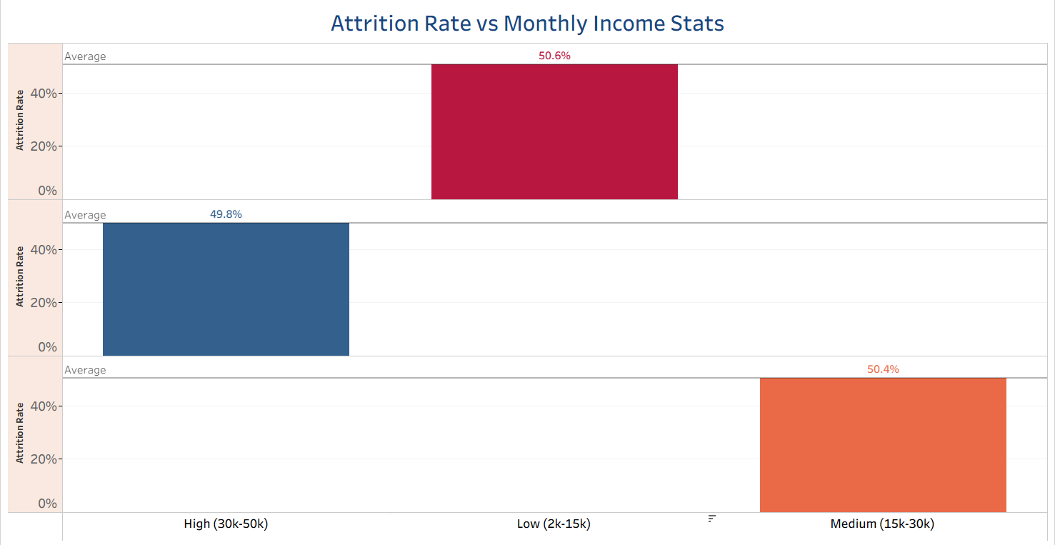

Slide 29
Insights & Recommendations
High attrition across all Income Range
High Income band also has 49% AR
Conclusive that other factors : Work Culture, Career growth, Management style, Work Life Balance can be reasons
Recommendation
Focus on Non Financial Factors

Slide 30
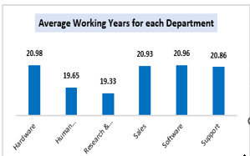
KPI 4: Average working years for each Department
Healthy Range : 4-8 yrs

Slide 31
Insights & Recommendations
Lack of Advancement opportunities
Mid-Late Career disengagement
Reduced Innovation
Resistance to change
Skill stagnation
Lack new Perspectives
Recommendation
Explore Career Pathing for Senior Employees
Promote Internal Mobility – for challenged employee engagement
Encourage continuous learning through training and certifications

Slide 32
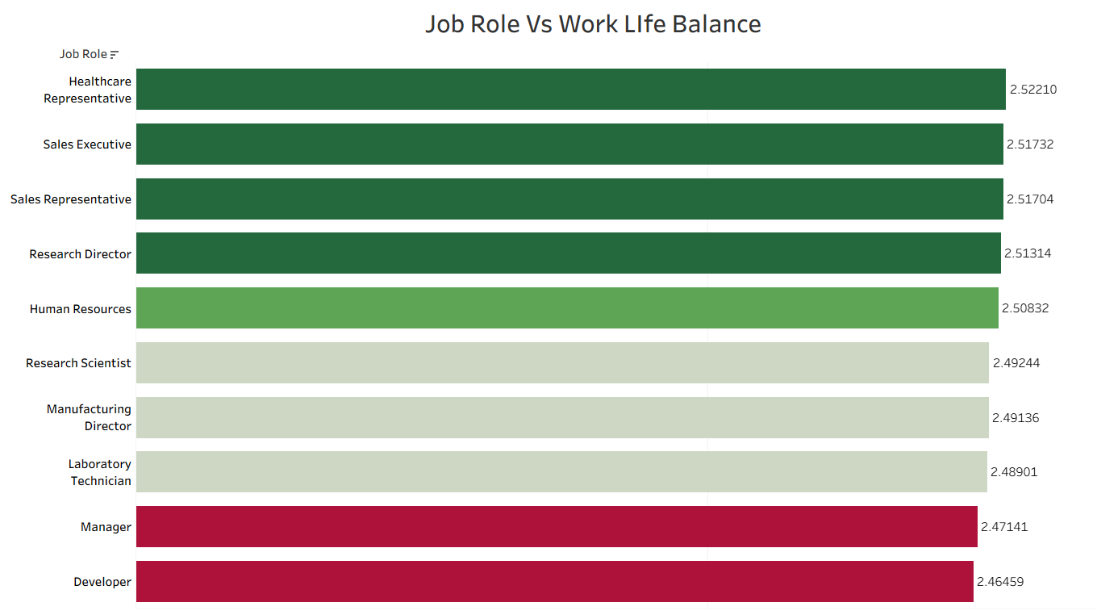
KPI 5: Job Role Vs Work life balance

Slide 33
Healthy Benchmark: 3 out of 4
Here, Moderate Satisfaction
Around 0.5
Risks:
High Burnout Risk if unaddressed.
Health issues due to High (114.45 hrs) Average Working Hours
Leads to High Attritions
Suggestions:
Encourage flexible schedules to reduce stress.
Offer wellness programs to support mental health.
Promote realistic workloads by auditing tasks and redistributing.
Strengthen leave policies to align with global best practices.

Slide 34
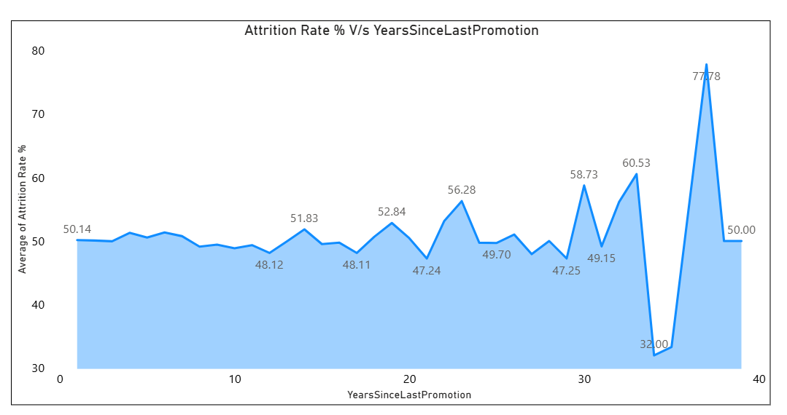
KPI 6: Attrition rate Vs Year since last promotion relation

Slide 35
Insights & Recommendations
Promotions delayed = Attrition spikes.
Career progression is directly tied to retention
Attrition spikes at certain intervals (e.g., 58–77% after long gaps without promotion).
Recommendation
Implement promotion policies or career development programs to reduce attrition.

Slide 36
